Slide 1
Does Media Coverage Drive Support for UKIP? j.mp/ukip-media
Justin Murphy
jmrphy.net
@jmrphy
Daniel Devine

Slide 2
Overview
Motivation, background and hypotheses
Data and methods
Findings
Conclusion

Slide 3
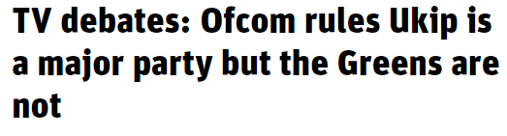
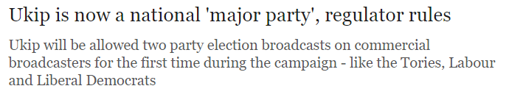

“The level of support for UKIP exhibited in the opinion poll data for England and Wales has been growing steadily for a number of years.”
Notes:
Top left – new statesman
Middle – telegraph
Middle – Guardian
Bottom – Ofcom
Importantly for the General Election 2015, UKIP were made equal, in terms of rights to coverage, as the traditional Labour, Conservatives and Lib Dems. The justification for Ofcom’s decision lay in, firstly, the European and Local elections, but secondly, that UKIP were polling high enough numbers to make them a large party. There is causal reasoning in this argument: that UKIP deserve high media coverage on the basis of their previous political support. This is an acceptable response if media coverage is innocently responsive to political support. But what if political support is a result of disproportionate media coverage, and this is just another example of such a relationship? Our motivation is thus grounded in this contemporary regulatory debate.

Slide 4
Media visibility of right-wing political parties has a positive effect on their support (Boomgaarden and Vliegenthart, 2007; Vliegenthart et al, 2012).
There is some debate: Pauwels (2010) completely disputes a causal connection. Alternatively, Rooduijn (2014) and Deacon and Wring (2015) argue that electoral success drives coverage.
It may be that the coverage-political support nexus is different in different political systems, or that the relationship is different for UKIP in particular.
Notes:
We also have an academic motivation. Most of the research so far has shown that media coverage of right-wing parties has an effect on their support, led by by Boomgaarden and Vliegenthart. These studies have been carried out in Germany, Belgium and the Netherlands. They have also been validated with case studies on political parties, such as the Vlaams Blok (Walgrave and De Swert, 2004) and Fortuyn (Koopmans and Muis, 2009).
Nevertheless, some disagree with this. Pauwels critiques Boomgaarden and Vliegenthart’s articles conceptually and empirically and finds it wanting (though, there is an excellent back and forth between these two in Electoral Studies). Moreover, Rooduijn finds that electoral success of populist parties leads to an increase in populism within print media. Deacon and Wring engage in a qualitative case study of print media and argue that it was UKIP’s success which made them impossible to ignore.
It may be that coverage is different in a different political system. The vast majority of research so far has been in PR systems where we expect more diverse media and the media to operate differently; the relationship may change in the context of the UK system. It could also be that UKIP display different properties than other parties (there’s evidence that party characteristics can change this relationship, leader effects, internal organisation, etc)
To that end, we have two hypotheses.

Slide 5
Hypotheses
H1: Increases in media coverage lead to increased public support, controlling for previous levels of public support and previous levels of media coverage
H2: Increases in public support lead to increased media coverage, controlling for previous levels of media coverage and previous levels of public support.
Notes:
H1: i.e, that coverage drives public support
H2: i.e, the reverse causality hypothesis

Slide 6
Data and Method
‘Public support’ is measured by monthly polling on vote intentions by Ipsos MORI between January 2004 and September 2015.
‘Media coverage’ is measured by the monthly count of articles mentioning ‘UKIP’ or ‘UK Independence Party’ from all national newspapers over the same time period, using the database Nexis. This resulted in 65,416 articles.
We control for General and European elections by including them as binary variables (1 if election occurred in that month, 0 otherwise).
Notes:
European: June 2004, June 2009, May 2014
General: May 2005, 2010, 2015.

Slide 7
Data and Method
Quantitative Analysis
We use vector auto-regression (VAR) with Granger causality tests to test the hypotheses quantitatively.
Qualitative Analysis
A brief historical qualitative analysis of the period under study to understand what was actually going on in British politics at the time
Notes:
We adopt two approaches. Firstly, we test the hypotheses using vector auto regression, an ideal method for detecting causality in time series data. Secondly, we look at what was actually going on with UKIP, and British politics in general, over this entire time period. This involved reading the content of the news articles that we had gathered and placing them in context. The qualitative approach is particularly useful to see whether the data is spurious and to understand the substantive nature of these changes.

Slide 8
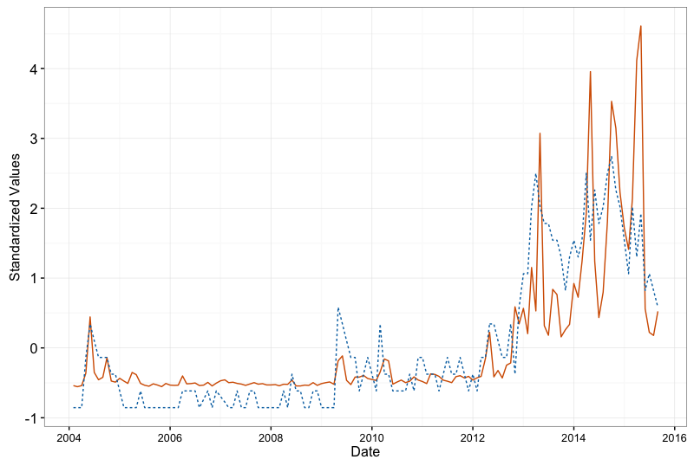
Findings (Articles, Support)
Notes:
To begin, this is an overview of our series. The blue dotted line represents articles, with the solid orange line representing vote intention or public support. It’s clear that UKIP’s support is characterised by sharp peaks followed by deep troughs. It’s also clear that UKIP were historically very poorly supported until around the middle of 2013 where their support generally increased.

Slide 9
Findings
There is statistically significant evidence (p: 0.037) that media coverage drives public support (hypothesis 1) but:
There is no evidence that changes in public support predict media coverage (hypothesis 2).
Notes:
The VAR results suggest considerable support for media coverage driving public support. In other words, past changes in media coverage have a statistically significant correlation with future changes in support; but there’s no correlation between past changes in public support and changes in media coverage. Full results are available, by the way, but included at the end.
There are naturally limitations imposed by the data, aside from theoretical limitations. Firstly, it may be that the ‘true lag’ between effects is shorter than a month, and so we are not picking up the true causality here. Secondly, structural tests indicate instantaneous causality, so it may be that both variables drive each other, or that there exists some other unobserved variable. These things aside, and acknowledging that the results are imperfect so far, we find strong evidence for hypothesis 1 and no evidence for hypothesis 2.

Slide 10
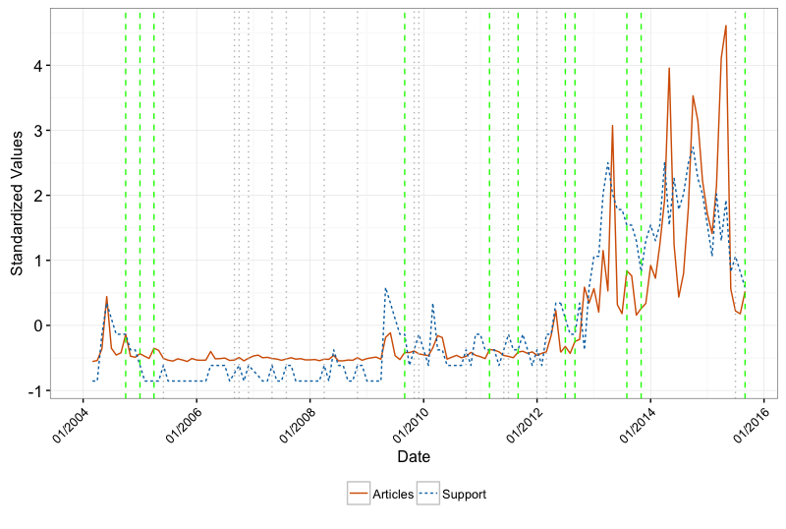
Findings
Notes:
This presents the standardized values of each time series with dashed and green vertical lines indicating months of uncaused media 'bias' and grey, dotted vertical lines indicating months of uncaused increases in public support. Even a first, superficial consideration reveals that increases in media coverage unwarranted by public support are not only roughly as frequent as uncaused increases in public support, but they are found at multiple pivotal months in periods of the most dramatic increases in UKIP's public support. Now, we are not trying to pick out exact areas of causality, which would be poor practice, but this nonetheless offers a nice visual overview of the dynamics and helps us pick out areas of interest to study qualitatively.
Defining these biases: any month t that is immediately preceded by two months of stagnating or declining public support but increased media coverage, this is ‘uncaused media increase’. A meaningful increase is >0.05 standard deviations.

Slide 11
Findings
There were two substantively significant increases in support which preclude and are unrelated to change in polls:
July to September, 2012
Media coverage for UKIP spikes despite stagnating then decreasing support. This continues until January 2013, when UKIP support spikes and continues on an upward trajectory.
2. November 2013
Despite poll ratings being at their lowest for the entire year, media coverage increases and is followed by a sustained increase in both series for a year.
Notes:
We take a qualitative look at some of these areas of interest and find at least two substantively significant points at which media coverage precludes growth in UKIP support. These, of course, do not prove anything empirically: it is equally possible to pick out some occasions where the reverse occurred. What they do, however, is illustrate some of the relationships which the VAR is picking up and help us think through what is behind these statistical regularities. The first occurs in July and August in the run up to the Corby by-election in November which generates media coverage which seems to prop up UKIP support until January 2013, where support itself spikes. This could be put down to the by-election. The second, however, in November 2013, is harder to explain. It is probably due to the lift of restrictions on Romanian and Bulgarian nationals in January 2014, and the linking of UKIP with the issue of immigration.

Slide 12
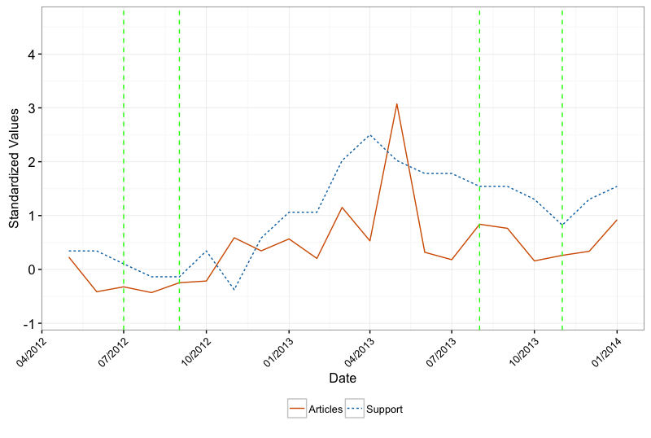
Findings
Notes:
This graph is zoomed in on the previous series, and picks up those two occurrences just discussed. We can come back to this if you have any questions.

Slide 13
Conclusion
We find qualified evidence that the media did independently generate support for UKIP over the time period under study;
Our results support previous findings in other political systems (such as the Netherlands, Belgium and Germany), supporting the generalisability of this finding;
We illustrate the substantive nature of these dynamics with a brief qualitative analysis of specific events;
We have contributed to a contemporary policy debate in the UK revolving around the regulation of media.

Slide 14
Conclusion – Future work
As with all studies, there are some limitations. Future work could consider:
Content analysis on the newspaper coverage used here.
Expanding the sample beyond print media
Understanding leader effects
Issue linkage?

Slide 15
